Slide 1

Security for Thin Client Deployments

Slide 2
1
2
3
4
Common Attacks and How to Reduce Risk
Introduction to ThinManager
How ThinManager Reduces Risk
ThinManager Security Demonstration

Slide 3

Common Security Attacks
Security attacks come in many forms, both internal and external
Types of malware attacks
Spyware, Viruses, Worms, Ransomware
Types of attack vectors
User bad intent
Planting malware
DDoS (Distributed Denial of Service)
SQL injection attack
Stealing user account info
Man-in-the-middle attacks
User accident
Browsing/downloading
Phishing victims - clicking links, social engineering attacks
Weak account passwords

Slide 4


ICS-Focused Campaigns, Attacks, Frequency
2010
2011
2012
2013
2014
2015
2016
2017
STUXNET
NIGHT DRAGON
SHAMOON
RED OCTOBER
HAVEX
BLACKENERGY
BLACKENERGY
NOTPETYA
Worm Targeting SCADA and Modifying PLCs
Advanced Persistent Threat Targeting Global Energy
Virus Targeting Energy Sector Largest
Wipe Attack
Cyber-Espionage Malware Targeting Gov’t & Research Organizations
Industrial Control System Remote Access Trojan & Information Stealer
Malware Injected into Ukrainian Power Company Network, Cut Power to the Affected Region.
Malware Injected into Power Company Network, Attackers Cut Power to the Affected Region.
Ransomware Malware Based
On Stolen NSA
Exploits that Impacted ICS Systems
OPERATION AURORA
FLAME
HEARTBLEED
DUQU
Virus use for Targeted Cyber Espionage in the Middle East
Security Bug and Vulnerability Exploited
by Attackers
APT Cyber Attack on 20+ High Tech, Security & Defense Companies
Worm Targeting ICS Information Gathering
and Stealing
OP GHOUL
INDUSTROYER
Spear-phishing Campaign Targeting Middle East Industrial Organizations
Malware Targeting Electric Utility – Used in 2016 Ukraine Grid Attack
GAUSS
Information Stealer Malware
WANNACRY
General ransomware which impacted ICS Systems
ICS CERT INCIDENT COUNT
**Only Reported Incidents in U.S.
295
290
197
257
245
140

Slide 5
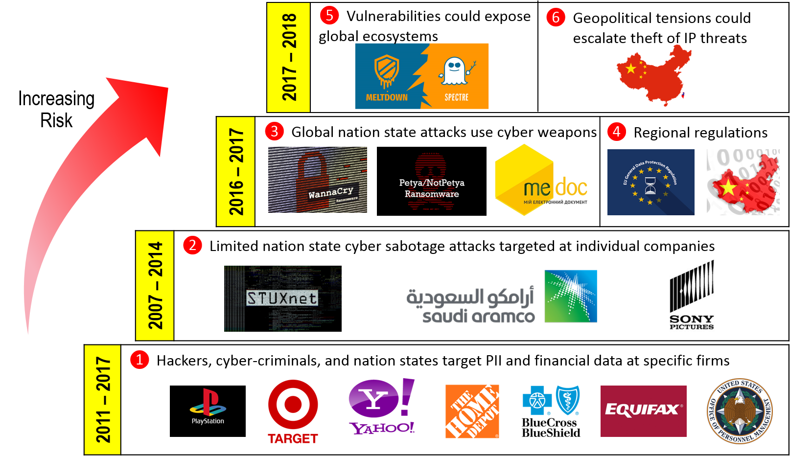
Evolving Threats
2017-2018
2016-2017
2007-2014
2011-2017
INCREASED RISK

Slide 6

Reduce Risks of Security Breaches
Concepts seen across industries that prevent the loss of data and reduce the risk of a security breach
Restrict access
Secure data
Backup data
Limit removable storage
Require strong passwords and rotate
Educate to avoiding social engineering attacks
Encrypt communications
Antivirus, intrusion detection/prevention

Slide 7
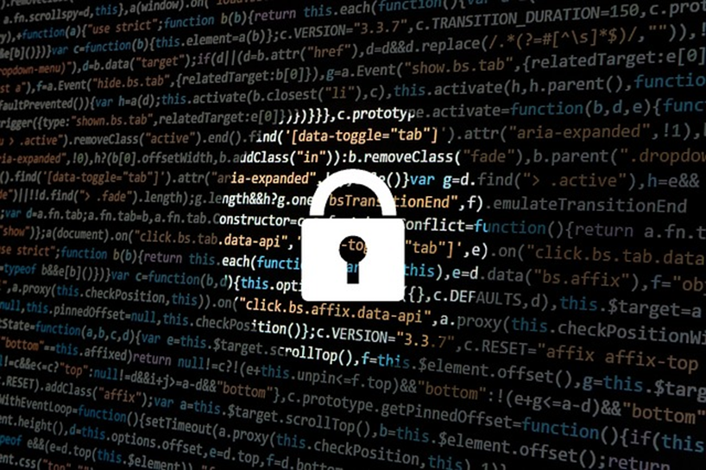
Reduce Risks of Security Breaches
ThinManager safely and security delivers content to any combination of device, user, and location.
Updates/patches – OS, applications
Remove legacy software
Thorough network segmentation
Firewalls/ ACLs/ port security/ IDMZ/ Wireless AP policies
Reduce downtime
Delivering the right content to the right person and the right place and time
Mobile Device Management Software (kiosk mode)

Slide 8

















ThinManager®
Content Delivery and Device Management
Content Types
Configuration
Delivery
PanelView™ Plus
PanelView™ 5000
Devices
HMI
ERP
MES
CMMS™
User X
Users
Group X
Web Content
Role X
ThinManager® provides secure
configuration and delivery of content
Locations
IP Camera
USB Camera
…AND MORE!
Notes:
Script:
Some of the more common Content Types are represented in the column on the left.
ThinManager can connect to VNC Servers as sources of content. This will enable shadowing of the PanelView Plus, and plug it into all of the unique ways that ThinManager can assign and deliver content.
ThinManager also connects to and delivers Windows based content.
It is important to note that ThinManager is an agnostic platform, so any Windows based content can be delivered.
The most common way that Windows based content is delivered with ThinManager is using Microsoft’s Remote Desktop Services (formerly called Terminal Services). It is not the only way, but the most common way.
Often times, it is assumed that ThinManager requires, or is dependent on Remote Desktop Services, but that is not the case.
With that said, while it is not required, since ThinManager is often deployed with Remote Desktop Services, you will typically find ThinManager installed on a Remote Desktop Server.
What is a Remote Desktop Server? This is a Windows Server based operating system (like Server 2008/2012/2016) that has the Remote Desktop Services role installed and configured. With this role installed, the server can then host multiple, independent Remote Desktop sessions from devices like thin clients, tablets, etc.
So, instead of installing FactoryTalk View SE on a number of PCs throughout the facility, you could instead install the FactoryTalk View SE Client on a Remote Desktop Server and use ThinManager to launch and distribute multiple instances of it.
In addition to Windows-based content, ThinManager supports IP or USB Cameras. ThinManager can tap into the camera’s video stream and deliver it to a device managed by ThinManager.
ThinManager also supports Terminal Shadowing. Shadowing is the ability to see a terminal remotely. Shadowing is supported through the ThinManager Admin Console, so you can see and remotely control any terminal managed by ThinManager centrally. We also extend this concept so terminals can shadow other terminals – this is called Terminal to Terminal shadowing. A single terminal can be shadowed by several other terminals. The shadowed sessions can be remotely controllable or view only.
So, what are the ways in which ThinManager can deliver the content of the Connected Enterprise?
ThinManager can assign and deliver content in 3 ways – By Device, By User and By Location.
By Device:
Every device managed in ThinManager will have a unique Terminal Profile.
The Terminal Profile is linked to the device based on the device’s MAC address.
The Terminal Profile defines the device’s default content and its other characteristics (i.e.: if it needs a touchscreen driver, is it permitted to be shadowed, etc.)
It is very common to assign FactoryTalk View SE as the default content for a device so it is automatically delivered when the device boots up.
By User:
In addition, content can be assigned to a user or a user group.
In this way, when a user logs in at any terminal managed by ThinManager, that user’s assigned content will be delivered (i.e.: a Maintenance user may receive an instance of Logix Designer, or maybe the Work Order System Client, etc.)
By Location:
Location is the foundation of ThinManager’s mobility initiative, called Relevance.
It allows content to be assigned and delivered to a mobile device based on its physical location.
As an example, a QR Code could be placed on a PLC panel. When a Maintenance user scans the QR Code, Logix Designer could be delivered to their mobile device with the correct ACD file opened up automatically.
As another example, maybe you permit a user to access the FactoryTalk View SE Client from their mobile device, but you want to physically limit where they can access it from. With Relevance, you can geo-fence content in based on the mobile device’s location (using Bluetooth Beacons, GPS, Access Points, etc.)
==========
SHORT SCRIPT:
ThinManager can easily deliver all kinds of content that your workforce needs to do their jobs. ThinManager securely delivers that content to any combination of device, user or location. This graphic shows examples of content, device, user and location.
Thin client networks are inherently more secure than traditional PC networks but ThinManager increases security even further by employing powerful user authentication techniques and the ability to designate specific locations for content delivery within your facility.
ThinManager is a Content Delivery and Device Management Platform.
Content Sources can be created and managed centrally.
Each device managed by ThinManager is assigned a unique terminal profile within ThinManager.
A device can be a thin/zero client, mobile device, or PC and each are managed in exactly the same way within ThinManager.
Content can be assigned and delivered by any combination of Device, User, and Location.

Slide 9
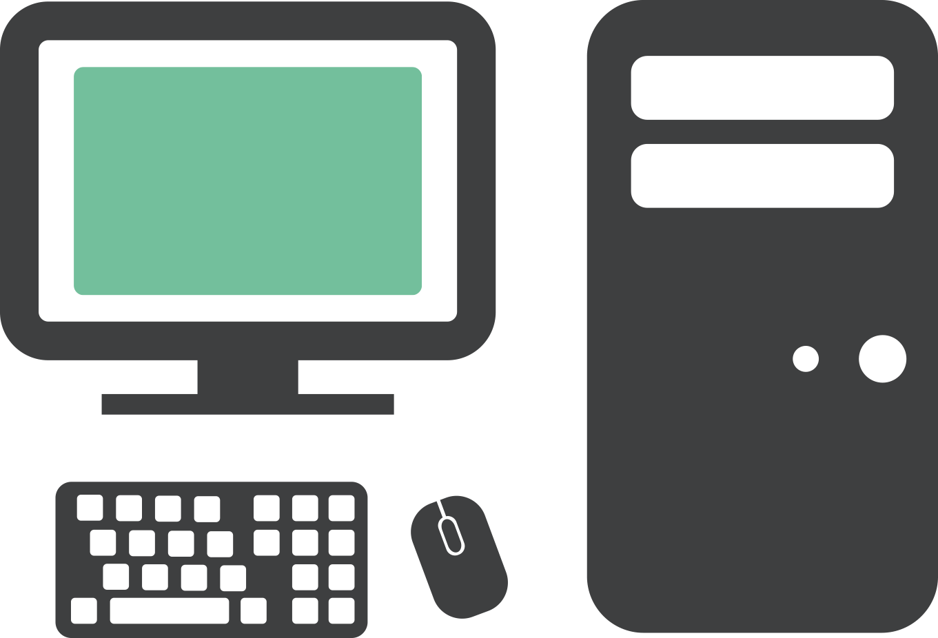
Traditional Automation Network
Dedicated PCs for Dedicated Applications
Control Room
OS
OS
APPS
USB
ACCESS
APPS
USB
ACCESS
OS
OS
OS
APPS
USB
ACCESS
APPS
USB
ACCESS
APPS
USB
ACCESS
ANTI-
VIRUS
MOVING
PARTS
ANTI-
VIRUS
MOVING
PARTS
ANTI-
VIRUS
MOVING
PARTS
ANTI-
VIRUS
MOVING
PARTS
ANTI-
VIRUS
MOVING
PARTS
OS
OS
OS
APPS
USB
ACCESS
APPS
USB
ACCESS
APPS
USB
ACCESS
OS
OS
APPS
USB
ACCESS
APPS
USB
ACCESS
ANTI-
VIRUS
MOVING
PARTS
ANTI-
VIRUS
MOVING
PARTS
ANTI-
VIRUS
MOVING
PARTS
ANTI-
VIRUS
MOVING
PARTS
ANTI-
VIRUS
MOVING
PARTS
Plant Floor
Plant Floor Offices
Notes:
Script:
Traditionally, Windows based applications were hosted on PCs in manufacturing areas.
Quite often, these PCs ran dedicated applications like FactoryTalk View SE, restricting access to the Windows desktop.
In general, a Windows desktop experience is not required, and sometimes not desired – especially on the Plant Floor or in the Control Room.
This environment requires management of support of many operating systems, many times each at different version and service pack levels.
In addition to the locally installed OS, the applications required must be managed at each PC, and anti-virus must be deployed and managed as well.
These PCs are generally not industrial, so they tend to have moving parts like hard drives, fans, and commercial grade power supplies that are all prone to failure.
Replacement of a PC, even with well managed external images, will typically take hours, resulting in costly downtime.
Lastly, the PCs are more susceptible to virus infection because their USB ports are used with flash drives.

Slide 10

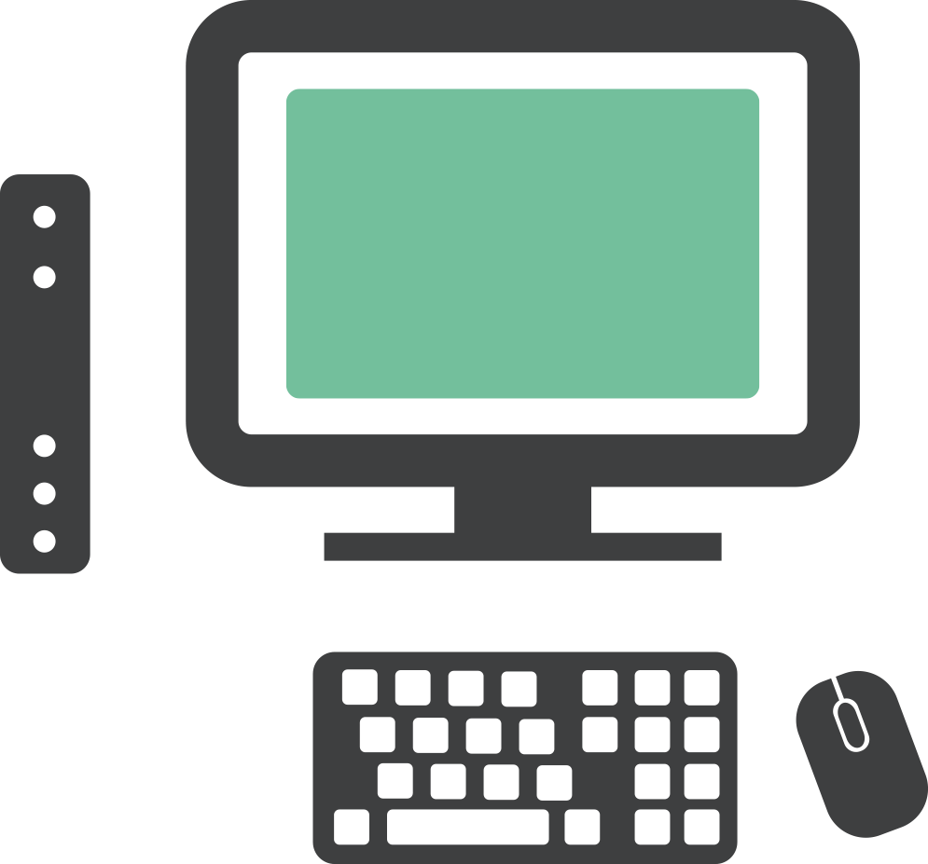

ThinManager Solution
Replace PCs with Thin Clients and Manage Centrally
Control Room
OS
APPS
ANTI-
VIRUS
OS
OS
APPS
USB
ACCESS
APPS
USB
ACCESS
OS
OS
OS
APPS
USB
ACCESS
APPS
USB
ACCESS
USB
ACCESS
APPS
ANTI-
VIRUS
MOVING
PARTS
ANTI-
VIRUS
MOVING
PARTS
Server Room
ANTI-
VIRUS
MOVING
PARTS
ANTI-
VIRUS
MOVING
PARTS
ANTI-
VIRUS
MOVING
PARTS
OS
OS
OS
APPS
USB
ACCESS
APPS
USB
ACCESS
APPS
USB
ACCESS
OS
OS
APPS
USB
ACCESS
APPS
USB
ACCESS
ANTI-
VIRUS
MOVING
PARTS
ANTI-
VIRUS
MOVING
PARTS
ANTI-
VIRUS
MOVING
PARTS
ANTI-
VIRUS
MOVING
PARTS
ANTI-
VIRUS
MOVING
PARTS
Plant Floor
Plant Floor Offices
Notes:
Script:
A ThinManager solution looks more like this – where PCs are generally replaced by thin clients. Any of the Windows based applications are then hosted centrally – typically on a Remote Desktop Server.
This architecture dramatically reduces the number of operating systems that need to be maintained – whether they are physical or virtual.
It also increases security at the endpoint, because nothing is stored on the actual ThinManager managed thin client. And USB ports on these devices are disabled by default for everything except keyboards and mice.
Adding ThinManager to this deployment provides an added layer of management that brings some very unique, plant-floor centric capabilities to the table.
As a side note – PCs can be retained and managed in a ThinManager deployment as well.
ThinManager offers a Windows based application called WinTMC that will essentially emulate a ThinManager thin client from a Windows OS. This is sometimes utilized if there are some applications that must continue to run locally, while additional remote content is managed from ThinManager.
Alternatively, some PCs can be PXE booted (PXE is an Intel standard = Preboot Execution Environment = a way to deliver firmware/operating systems over the network at boot time), where the PC would be booted from the ThinManager firmware, as opposed to its locally installed OS.

Slide 11
Enhance and Simplify Security Initiatives
Reducing the Attack Surface
Using thin clients with ThinManager
The firmware – Extremely lightweight OS with only the necessary processes running
Only a means of connecting to content (no local data or storage)
USB/CD/DVD/floppy – external devices not enabled by default
Clients
Servers
ThinManager user terminals do not store local data and reduce your plant floor attack surface

Slide 12
Enhance and Simplify Security Initiatives
Reducing the Attack Surface
Application Centralization
Applications run on centralized servers not standalone PCs, more secure environments
Less OS’s – personal account of WannaCry episode
Established password-secured/encrypted protocols – RDP, VNC, streaming protocols
Encrypted RDP comms between source and client (TLS 1.2 negotiation)
Low port count
Clients
Servers
Clients only access content from centralized servers

Slide 13
Enhance and Simplify Security Initiatives
Reducing the Attack Surface
Network Segmentation
Reduced access and traffic
Firewalls (low port count simplifies firewall support)
ACLs and port security
Comms redirection/proxy and isolation
  IDMZ
Clients
Servers
ThinManager eases network segmentation efforts to increase plant floor security

Slide 14
Enhance and Simplify Security Initiatives
Centralize Access Control
Application Centralization
Application Link – delivering only the application to a terminal
Multifactor Authentication – “something you have plus something you know”
Authentication Pass-through – simplify and streamline authentication with FactoryTalk View SE
Require administrator to enable external hardware (serial port redirection, removable storage, badge/biometric readers)
Access Groups for permissions to access assets
Security management with ThinManager much simpler than using
GPOs or local policies (ex. user session inactivity timeout, app delivery)
Clients
Servers
ThinManager allows you to centrally manage access to productivity applications

Slide 15
Enhance and Simplify Security Initiatives
Centralize Access Control
Application Centralization
ThinManager security for administration console
Active Directory Integration
Relevance user/location based delivery (line of sight, location + permission, application transfer of ownership, nested resolvers), User based delivery – a form of mobility
Shadowing (warning prompt)
Key block module
Terminal replacement can be restricted
Clients
Servers
ThinManager allows you to centrally manage access to productivity applications

Slide 16
Enhance and Simplify Security Initiatives
Simplify Lifecycle Support
Lifecycle Management
Patch/Upgrade effort reduced with centralized content (RDS, less PCs to maintain)
  HA options for RDS and ThinManager redundancy
Don’t have to take the system down to patch/upgrade components
  More incentive to keep up-to-date on everything, legacy systems are most vulnerable to new attacks
Clients
Servers
ThinManager reduces OS maintenance and hardware life cycle support

Slide 17
Enhance and Simplify Security Initiatives
Simplify Lifecycle Support
Virtualization Support
Imaging VMs/Snapshots for easier qualification and restoration, if needed
Antivirus clients and scans can be offloaded from each VM onto a centralized antivirus template which can scan VMs with dedicated resources
Clients
Servers
ThinManager securely delivers physical and virtual content to user terminals

Slide 18
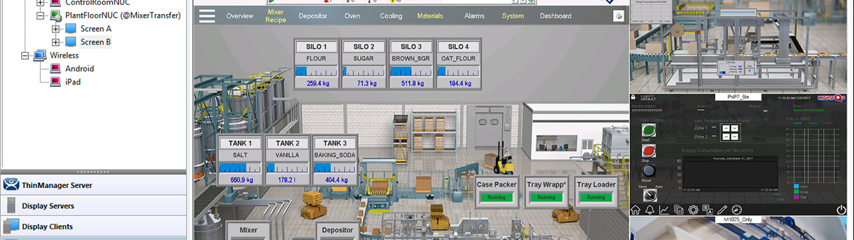
ThinManager Security Demonstration
End Device Management
Zero Clients
User Authentication
App Link
Permissions
USB Access
Key Block
AD Synchronization
Location Based Delivery
Authentication Pass-Through
Alternative Login

Slide 19
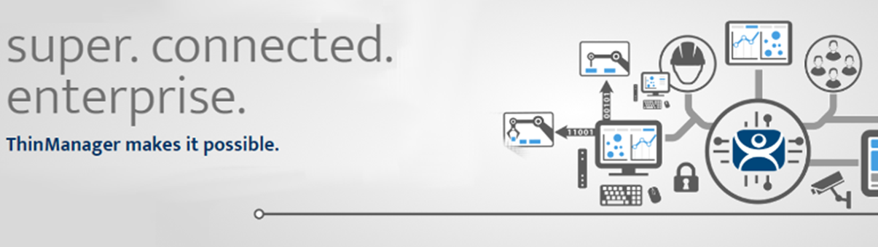
Recognizing Opportunity
Lowering Total Cost of Ownership is the core value proposition.
---------------------------------------------------------------------------------------------
New projects deploying productivity applications like: HMI,MES, etc.
Security initiatives, Mobility initiatives and Cost Savings
No content is stored on ThinManager-managed terminals
Location based content delivery is unique to ThinManager
Green/sustainability initiatives – less power to run thin clients

